Slide 1

Artificial Intelligence
Search algorithms
CS-632
Dr. Muhammad Aqib
University Institute of Information Technology
PMAS-Arid Agriculture University Rawalpindi

Slide 2
Informed (Heuristic) search
Heuristic search is an AI search technique that employs heuristic for its moves.
Heuristic is a rule of thumb that probably leads to a solution.
Heuristics play a major role in search strategies because of exponential nature of the most problems. Heuristics help to reduce the number of alternatives from an exponential number to a polynomial number.

Slide 3
Heuristic search
In Artificial Intelligence, heuristic search has a general meaning, and a more specialized technical meaning.
In a general sense, the term heuristic is used for any advice that is often effective but is not guaranteed to work in every case.
Within the heuristic search architecture, however, the term heuristic usually refers to the special case of a heuristic evaluation function.

Slide 4
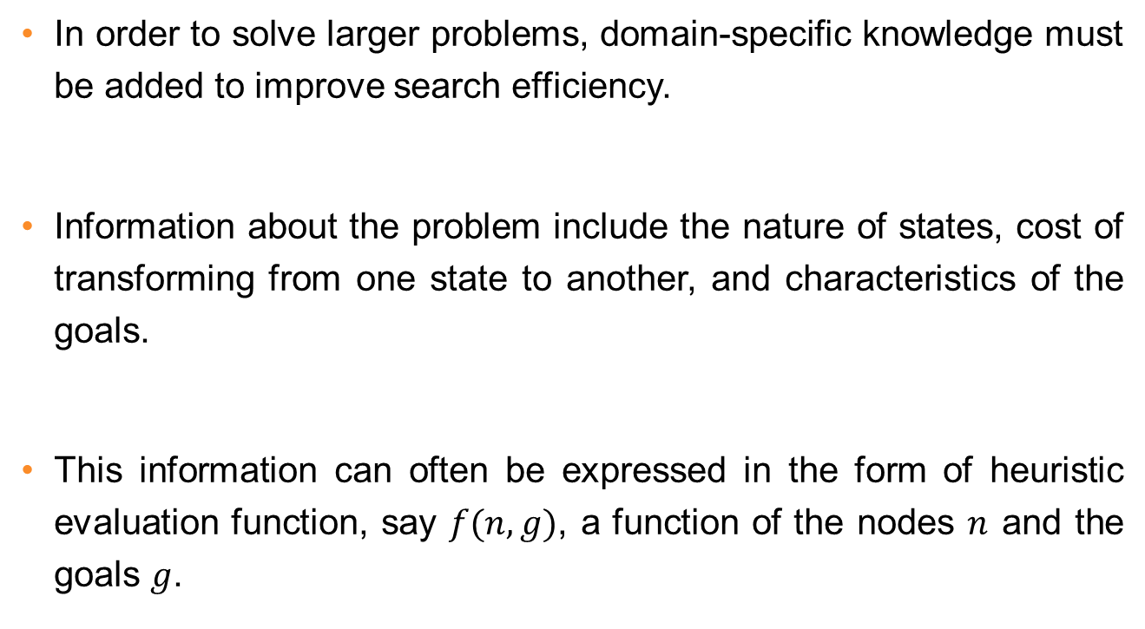
Heuristic information

Slide 5
Heuristic evaluation function
Heuristic evaluation function estimates the cost of an optimal path between a pair of states in a single-agent path-finding problem.
For example, Euclidean or airline distance is an estimate of the highway distance between a pair of locations.

Slide 6
Manhattan Distance
Manhattan distance is a common heuristic function for the sliding-tile puzzles.
Manhattan distance is computed by counting the number of moves along the grid that each tile is displaced from its goal position and summing these values over all faces.

Slide 7
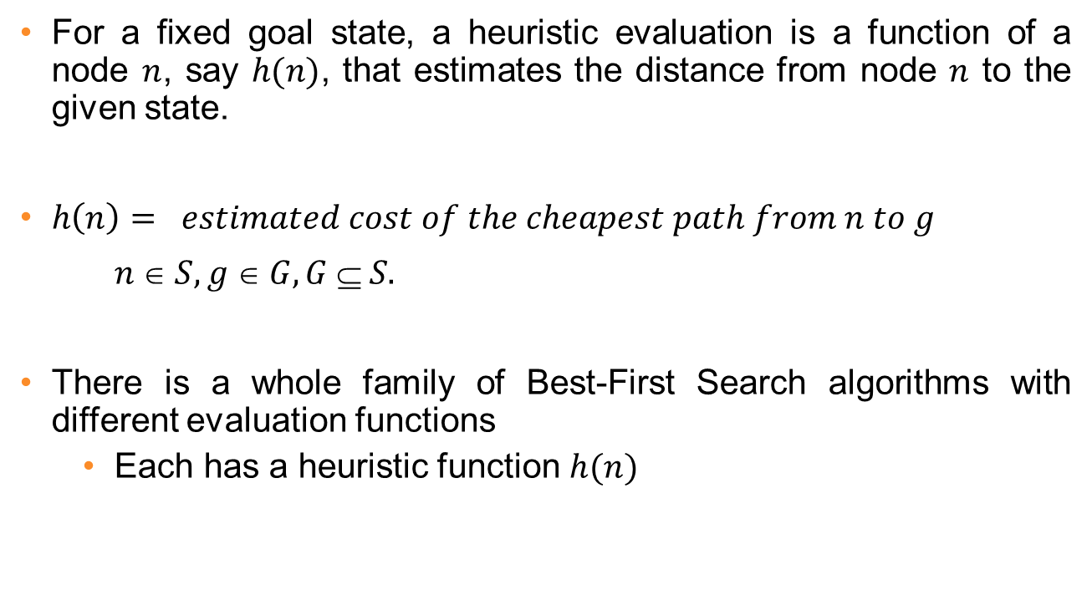
Heuristic evaluation function

Slide 8
heuristic search techniques
Greedy best-first search
A* search
Recursive best-first search
Pure Heuristic Search
Iterative-Deepening A*
Depth-First Branch-And-Bound
Heuristic Path Algorithm

Slide 9
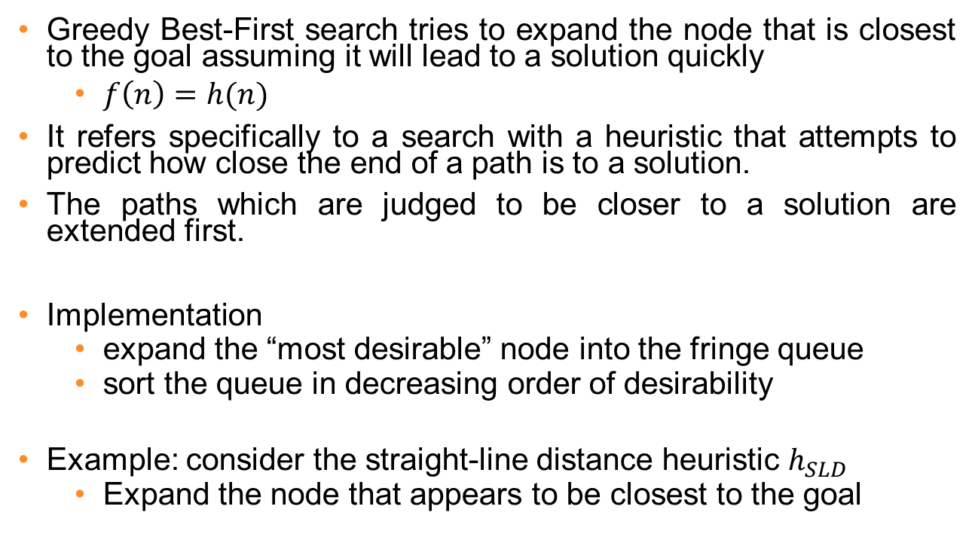
Greedy Best-First Search

Slide 10
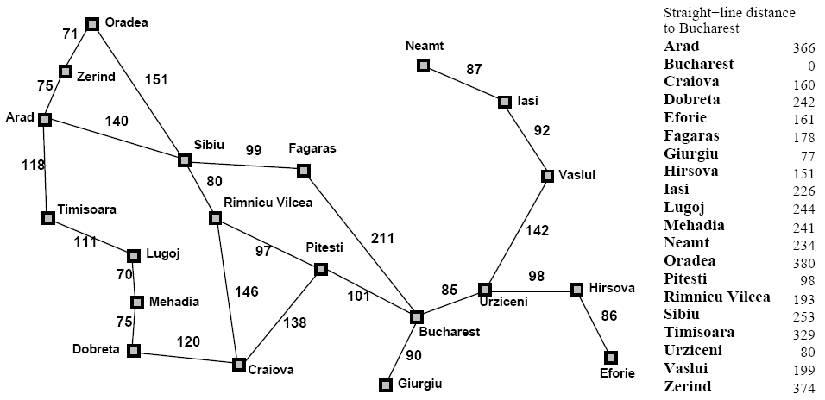
Greedy Best-First Search

Slide 11
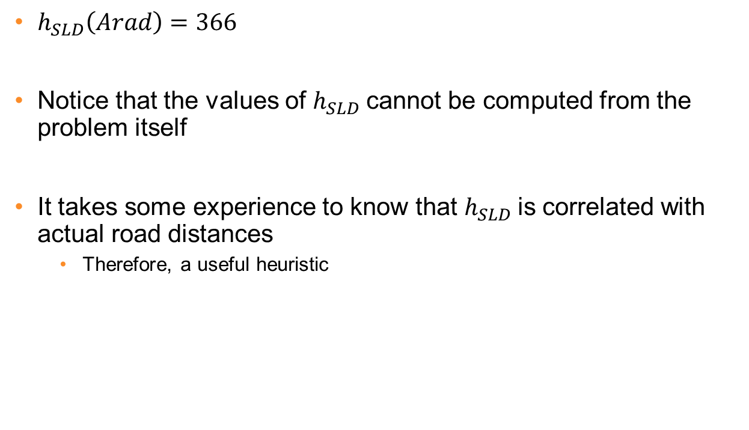
Greedy Best-First Search

Slide 12

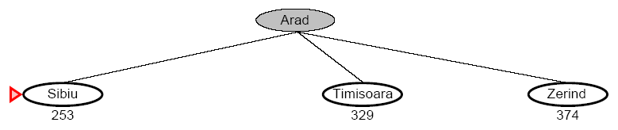
Greedy Best-First Search

Slide 13
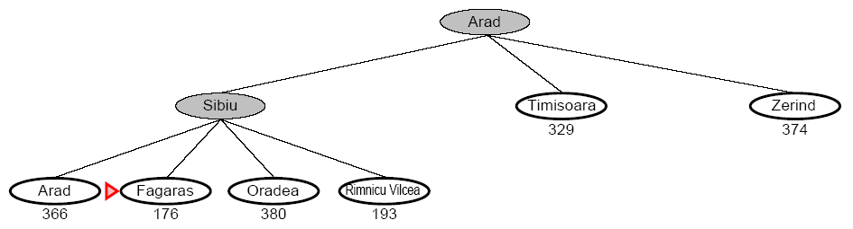
Greedy Best-First Search

Slide 14
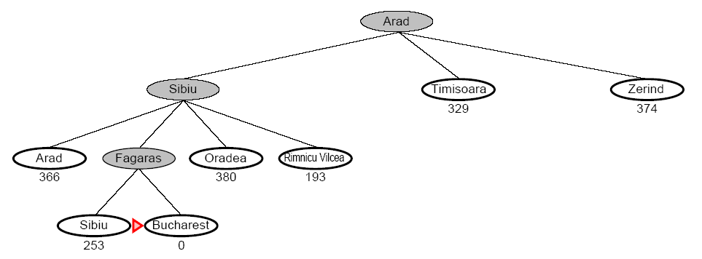
Greedy Best-First Search

Slide 15
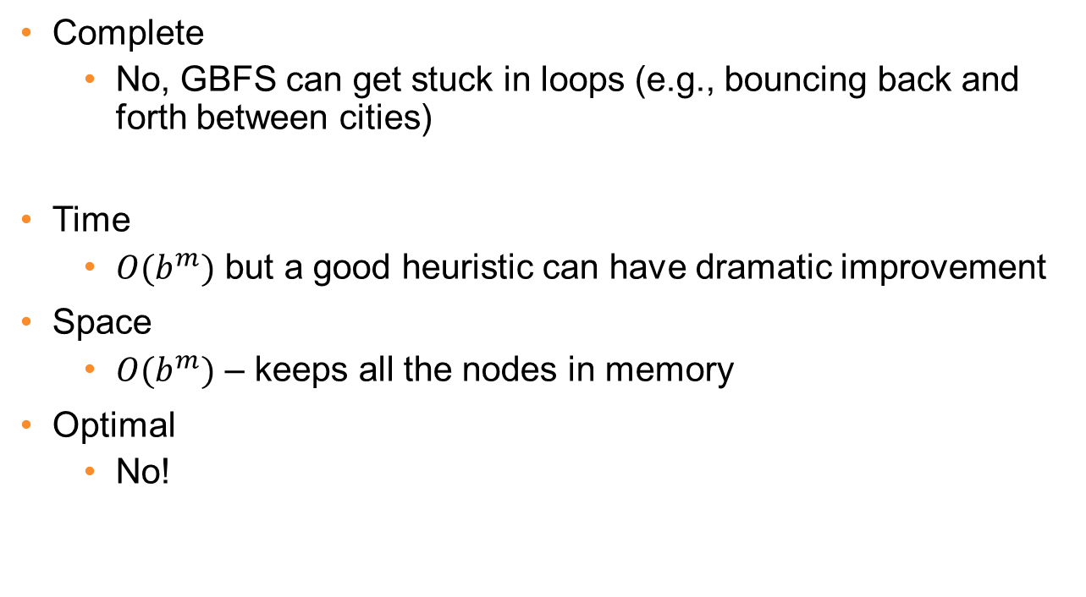
Greedy Best-First Search

Slide 16
Robot Navigation

Slide 17
Robot Navigation
8
7
6
5
4
3
2
3
4
5
6
7
5
4
3
5
6
3
2
1
0
1
2
4
7
6
5
8
7
6
5
4
3
2
3
4
5
6

Slide 18
Robot Navigation
8
7
6
5
4
3
2
3
4
5
6
7
5
4
3
5
6
3
2
1
0
0
1
2
4
7
7
6
5
8
7
6
5
4
3
2
3
4
5
6

Slide 19
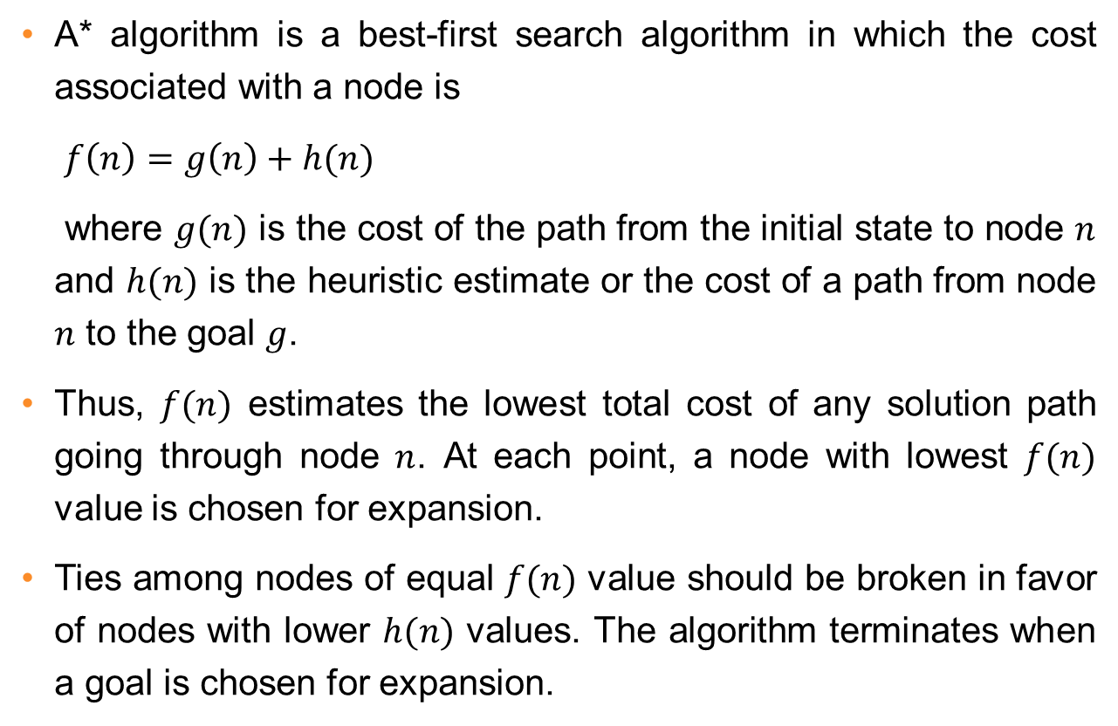
A* Search

Slide 20
A* Search
A* (A star) is the most widely known in AI
It evaluates nodes by combining g(n) and h(n)
f(n) = g(n) + h(n)
Where
g(n) = cost so far to reach n
h(n) = estimated cost to goal from n
f(n) = estimated total cost of path through n

Slide 21
A* Search
When h(n) = actual cost to goal
Only nodes in the correct path are expanded
Optimal solution is found
When h(n) < actual cost to goal
Additional nodes are expanded
Optimal solution is found
When h(n) > actual cost to goal
Optimal solution can be overlooked

Slide 22
Greedy Best-First Search

Slide 23

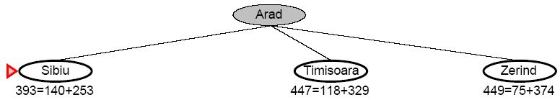
A* Search

Slide 24
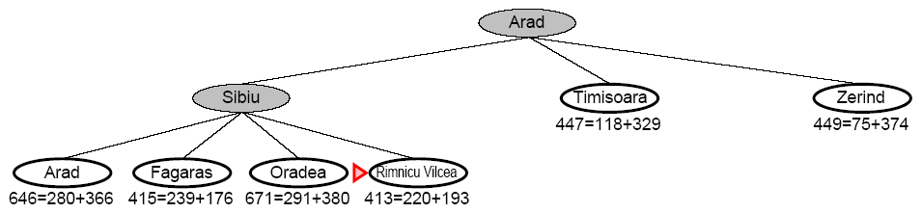
A* Search

Slide 25
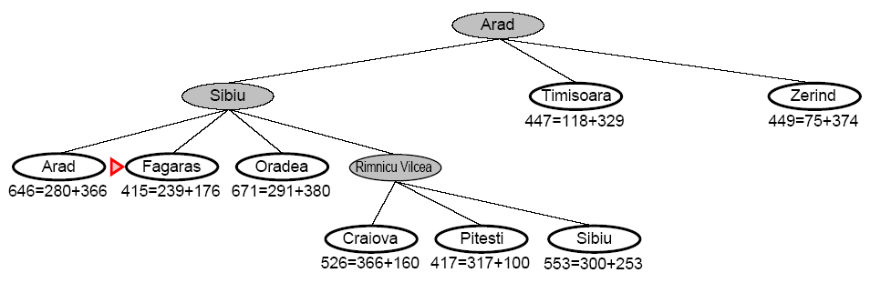
A* Search

Slide 26
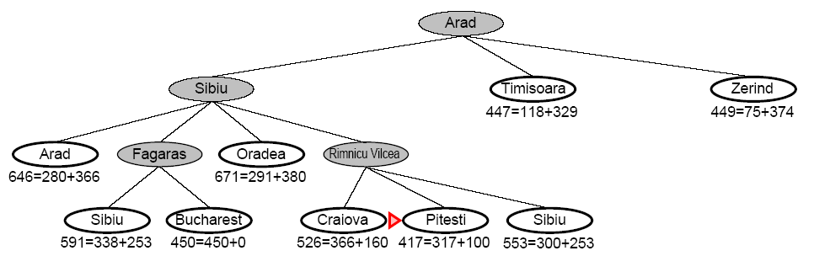
A* Search

Slide 27
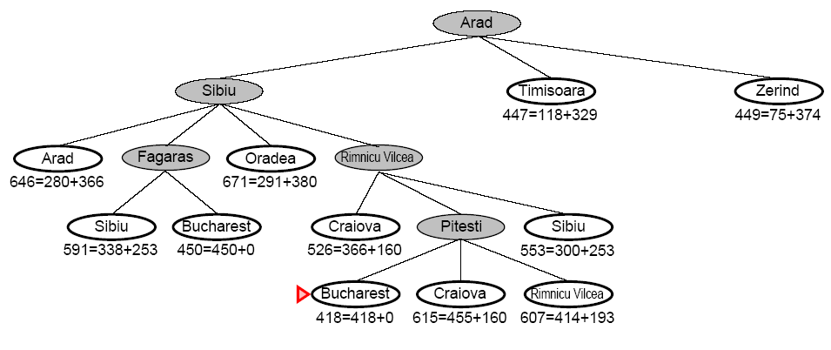
A* Search

Slide 28
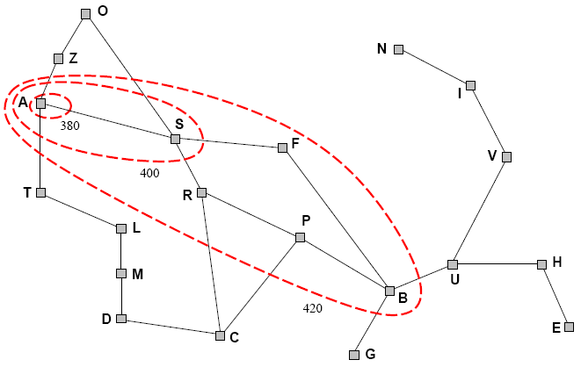
A* Search
A* expands nodes in increasing f value
Gradually adds f-contours of nodes (like breadth-first search adding layers)
Contour i has all nodes f=f_{i} where f_{i} < f_{i+1}

Slide 29
A* Search
Complete
Yes, unless there are infinitely many nodes with f <= f(G)
Time
Exponential in [relative error of h x length of soln]
The better the heuristic, the better the time
Best case h is perfect, O(d)
Worst case h = 0, O(b^{d}) same as BFS
Space
Keeps all nodes in memory and save in case of repetition
This is O(b^{d}) or worse
A* usually runs out of space before it runs out of time
Optimal
Yes, cannot expand f_{i+1} unless f_{i} is finished

Slide 30
Once more
We kept looking at nodes closer and closer to the goal, but were accumulating costs as we got further from the initial state
Our goal is not to minimize the distance from the current head of our path to the goal, we want to minimize the overall length of the path to the goal!
Let g(N) be the cost of the best path found so far between the initial node and N
f(N) = g(N) + h(N)

Slide 31
Robot Navigation
f(N) = g(N)+h(N), with h(N) = Manhattan distance to goal
8+3
8+3
7+4
7+4
6+5
6+3
5+6
5+6
4+7
4+7
3+8
3+8
2+9
8
7
6
5
4
3
2+9
3+10
2
3
4
5
6
7+2
7+2
5+6
4+7
3+8
7
5
4
3+8
3
5
6+1
6+1
2+9
2+9
1+10
6
3
2
1+10
0+11
1
0
1
2
4
7+0
7+0
6+1
7
6+1
6
5
8+1
8+1
7+2
7+2
6+3
6+3
5+4
5+4
4+5
4+5
3+6
3+6
2+7
8
7
6
5
4
3
2+7
3+8
2
3
4
5
6

Slide 32
Complexity Of Finding Optimal Solutions
The time complexity of a heuristic search algorithm depends on the accuracy of the heuristic function.
For example, if the heuristic evaluation function is an exact estimator, then A* search algorithm runs in linear time, expanding only those nodes on an optimal solution path.
Conversely, with a heuristic that returns zero everywhere, A* algorithm becomes uniform-cost search, which has exponential complexity.

Slide 33
Thank You

